Slide 1
Back to Basics: Title III/VI Coordination
1
May 23, 2024
Kari Benson, Deputy Assistant Secretary for Aging, Administration on Aging
Cynthia LaCounte, Director, Office of American Indian, Alaskan Native, and Native Hawaiian Programs (OAIANNHP)
Derek Lee, Regional Administrator, Region VI, Center for Regional Operations
Sonya Begay, Policy Analyst, OAIANNHP

Slide 2
Welcome
2

Slide 3
Agenda
3
Background
Older Americans Act (OAA) Final Rule Provisions
Summary and Resources
Please note: When a hyperlink is provided on a slide, the notes section will include the full website link.

Slide 4
Background
4

Slide 5
Facts on Tribal Elders, Tribes, and the Title VI Program
Almost 450,000: The projected number of older American Indians & Alaskan Natives by 2030
1978: The year the Title VI program was established as part of the Older Americans Act
574: The number of federally recognized tribes currently
291: The number of Title VI grantees in 2024, representing over 400 tribes and an organization serving Native Hawaiian elders and caregivers
Notes:
Slide link:
chrome-extension://efaidnbmnnnibpcajpcglclefindmkaj/https://acl.gov/sites/default/files/Profile%20of%20OA/AIANProfileReport2021.pdf

Slide 6
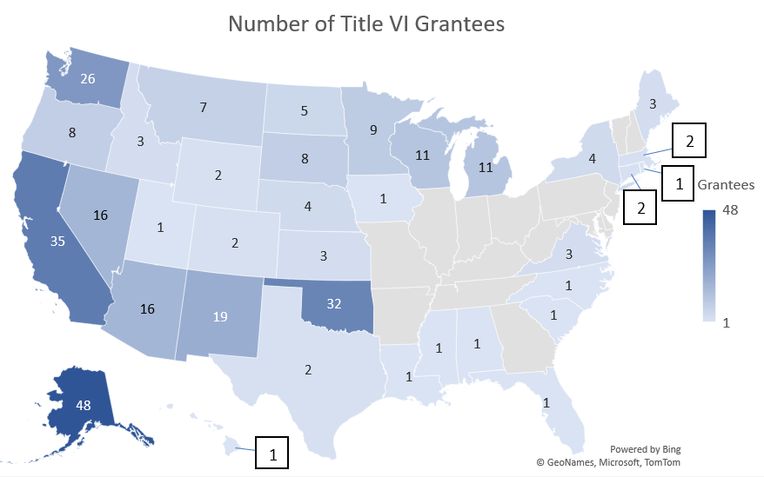
Title VI Grantees in 2024
6
Notes:
Picture of: https://olderindians.acl.gov/#gsc.tab=0

Slide 7

Older Indians Website
7
https://olderindians.acl.gov
Notes:
Slide link:
https://olderindians.acl.gov

Slide 8
Path to OAA Final Rule Updates
2022: Issued formal Request for Information & conducted listening sessions, including formal tribal consultations and discussions with all grantees
2023: Engaged in consultation at Title VI conference, issued formal Notice of Proposed Rule Making, held tribal consultation session regarding proposed rule, received comments from over 750 entities
2024: Published Final Rule, held tribal consultation session at Title VI conference, providing training and technical assistance to OAA programs
Thank you for your thoughtful, detailed input to support the national aging network and the Native American elders and family caregivers we serve!
Notes:
Slide link:
https://www.ecfr.gov/current/title-45/subtitle-B/chapter-XIII/subchapter-C

Slide 9
Older Americans Act (OAA)
9
First passed in 1965 and last reauthorized on March 25, 2020, the OAA authorized a wide range of programs and services that help older adults age in place. These include:
Home-delivered and congregate meals, support for family caregivers, preventive health services, personal and home care services, transportation, legal assistance, and more (Title III);
Nutrition and supportive services for Native American elders and caregivers (Title VI); and
Ombudsman services for people who live in long-term care facilities, prevention of elder abuse, and elder rights promotion (Title VII).
Notes:
Slide link:
https://acl.gov/sites/default/files/about-acl/2020-04/Older%20Americans%20Act%20Of%201965%20as%20amended%20by%20Public%20Law%20116-131%20on%203-25-2020.pdf

Slide 10
Key Sections of the OAA
10
Section 614(a)(11) – A tribal organization receiving Title VI funding must assure it will coordinate Title VI services with services provided under Title III in the same geographical area
Sec. 306(a)(11)(B) – Each area plan shall provide information concerning services to older Indians and assure the area agency on aging (AAA) will coordinate services with those provided under Title VI
Sec. 307(a)(21)(A) – The state plan shall assure that the State Unit on Aging (SUA) will coordinate programs under Title III with programs under Title VI

Slide 11
Expectations of States under the OAA
11
OAA funds to SUAs are based on their older adult populations (which includes American Indian, Alaskan Native, and Native Hawaiian elders). State plans on aging must provide assurances that:
the SUA will coordinate programs under Title III and programs under Title VI, if applicable; and
the SUA (including those with no Title VI grantees operating within the state’s borders) will pursue activities to increase access by older Native Americans to all aging programs and benefits provided by the agency, including programs and benefits provided under Title III, if applicable, and specify how the SUA intends to implement the activities.

Slide 12
OAA Program Regulations Background
12
The last substantial update to most OAA program regulations was in 1988. Since then:
the population of older adults has nearly doubled,
older adults are living longer than ever before, and
expectations for aging have shifted.
Then and now: Almost all older adults want to continue to live independently in the community, and nearly 95% do.

Slide 13
Purpose of the Final Rule Updating the OAA Regulations
Update regulations to align with the current statute
Reflect the needs of today’s older adults
Promote appropriate stewardship of OAA resources
Clarify programmatic requirements
Support the national aging network that delivers OAA services
Improve program implementation to better serve older adults and caregivers

Slide 14
General Note on the OAA Final Rule
14
The vast majority of what is included in the final rule are long-established OAA requirements – i.e., reaffirming what is in statute, prior regulations, or existing policies – rather than new requirements.

Slide 15
Timeline
15
  The OAA final rule became effective on March 15, 2024.
  ACL will provide robust training and technical assistance and will work with SUA and Title VI grantees to come into compliance.
      AAAs should work closely with their SUA, and service providers should work closely with their AAAs (or SUA for single PSA states).
  The compliance date is October 1, 2025.

Slide 16
OAA Final Rule Provisions
16

Slide 17
Layout of the Final Rule
The Final Rule has two basic sections:​
  The first portion is the preamble:​
        Background​,
        Explanation of provisions of the final rule,
        Analysis and responses to public comments​, and
        Required regulatory analyses​
  The second portion is the final regulatory text in full for 45 Code of Federal Regulations (CFR)
        1321 (Title III),
        1322 (Title VI), and
        1324 (Title VII)
Notes:
Slide links:
https://www.govinfo.gov/content/pkg/FR-2024-02-14/pdf/2024-01913.pdf
https://www.ecfr.gov/current/title-45/subtitle-B/chapter-XIII/subchapter-C

Slide 18
Selected Parts of the New Regulations Applicable to Title VI and Title III Coordination
Part 1321 – Title III requirements
Subpart B (SUA)
  § 1321.27, § 1321.53
Subpart C (Area agency)
  § 1321.63, § 1321.65, § 1321.69
Subpart D (Services)
  § 1321.95
Subpart E (Emergency & disaster)
  § 1321.97, § 1321.103
Part 1322 – Title VI requirements
Subpart C (Services)
  § 1322.31
Subpart D (Emergency & disaster)
  § 1322.33, § 1321.37
Notes:
Slide links:
https://www.ecfr.gov/current/title-45/section-1321.27
https://www.ecfr.gov/current/title-45/section-1321.53
https://www.ecfr.gov/current/title-45/section-1321.63
https://www.ecfr.gov/current/title-45/section-1321.65
https://www.ecfr.gov/current/title-45/section-1321.69
https://www.ecfr.gov/current/title-45/section-1321.95
https://www.ecfr.gov/current/title-45/section-1321.97
https://www.ecfr.gov/current/title-45/section-1321.103
https://www.ecfr.gov/current/title-45/section-1322.31
https://www.ecfr.gov/current/title-45/section-1322.33
https://www.ecfr.gov/current/title-45/section-1322.37

Slide 19
Coordination - Reasons
19
Improve knowledge about available programs
Coordinate access to additional services for elders
Reduce duplication / expand efficiency
Amplify community support
Increase funding opportunities
Achieve access to information
Enhance cultural competency
Address comprehensive needs of elders

Slide 20
PART 1321—GRANTS TO STATE AND COMMUNITY PROGRAMS ON AGING
Notes:
Slide link:
https://www.ecfr.gov/current/title-45/part-1321

Slide 21
§ 1321.27 Content of State plan.
SUAs must have an approved State plan on aging to receive OAA Title III and VII funds. State plan content must include:
A description of how greatest economic need (GEN) and greatest social need (GSN) (definition at § 1321.3 includes isolation due to Native American identity) are determined and addressed, including methods to address prioritized populations;
An intrastate funding formula (IFF) showing how funds are distributed to AAAs, or a funds distribution plan for SUAs without AAAs;
Demonstration that:
  the determination of GEN and GSN specific to Native American persons is identified in communication among the SUA, tribes, tribal organizations, and Native communities;
  Title III & VI services will be coordinated; and
  the SUA will require AAAs to provide outreach where there are older Native Americans, including those living outside of reservations and other tribal lands.
Notes:
Slide links:
https://www.ecfr.gov/current/title-45/section-1321.27
https://www.ecfr.gov/current/title-45/section-1321.3

Slide 22
§ 1321.53 State agency Title III & Title VI coordination responsibilities.
SUA policies & procedures (P&P) must explain how the state aging network will coordinate with Title VI programs:
  Must be developed in coordination with relevant Title VI program director(s).
  SUAs may meet these requirements through a tribal consultation policy that includes Title VI programs.
Notes:
Slide link:
https://www.ecfr.gov/current/title-45/section-1321.53

Slide 23
§ 1321.53 State agency Title III & Title VI coordination responsibilities, cont.
P&P must address:
  How the aging network will provide outreach to tribal elders and family caregivers;
  Communication opportunities to include
    Title III and other funding opportunities;
    technical assistance on how to apply for Title III and other funding opportunities;
    meetings; email distribution lists; presentations; and public hearings;
  Methods for collaboration on and sharing of program information and changes;
  How Title VI programs may refer individuals for Title III or VII services;
  How services will be provided in a culturally appropriate and trauma-informed manner; and
  Opportunities to serve on advisory councils (including AAA), workgroups, and boards.
Notes:
Slide link:
https://www.ecfr.gov/current/title-45/section-1321.53

Slide 24
§ 1321.63 Area agency advisory council.
The OAA and the Final Rule require AAAs to have an advisory council to advise the AAA regarding the area plan on aging, representing the interests of older adults and family caregivers, and reviewing and commenting on policies, programs, and actions affecting older adults and family caregivers
  Membership must be at least 50% older individuals, with efforts to include those identified as in GEN and GSN
  May include others, including representatives from Indian Tribes, Pueblos, or Tribal aging programs
Notes:
Slide link:
https://www.ecfr.gov/current/title-45/section-1321.63

Slide 25
§ 1321.65 Submission of an area plan and plan amendments to the State agency for approval.
Area plan content, specified in SUA policies and procedures must include:
A description of how greatest economic need (GEN) and greatest social need (GSN) (definition at § 1321.3 includes isolation due to Native American identity) are identified and addressed;
Assessment and evaluation of unmet need;
Proposed description of services, individuals to be served, units of service, and expenditures;
How funds will be distributed within the AAA’s planning and service area; and
An opportunity for public participation regarding the area plan.
Notes:
Slide links:
https://www.ecfr.gov/current/title-45/section-1321.65
https://www.ecfr.gov/current/title-45/section-1321.3

Slide 26
§ 1321.69 Area agency on aging Title III and Title VI coordination responsibilities.
The AAA’s policies and procedures must:
explain how the AAA’s network, including service providers, will coordinate with Title VI programs to ensure compliance with the OAA;
address how the AAA’s network will provide outreach to tribal elders and family caregivers;
address the communication opportunities the AAA will make available to Title VI programs, to include Title III and other funding opportunities, technical assistance on how to apply for Title III, and other funding opportunities, meetings, email lists, presentations, and public hearings;
describe the methods for collaboration on and sharing of program information and changes, how services will be provided in a culturally appropriate and trauma-informed manner;
address how Title VI programs may refer individuals who are eligible for Title III services; and
detail opportunities to serve on advisory councils (including the AAA’s), workgroups, and boards.
Notes:
Slide link:
https://www.ecfr.gov/current/title-45/section-1321.69

Slide 27
§ 1321.95 Service provider Title III and Title VI coordination responsibilities.
§ 1321.95 addresses Title III service providers and is very similar in its requirements.
Notes:
Slide link:
https://www.ecfr.gov/current/title-45/section-1321.95

Slide 28
PART 1322—GRANTS TO INDIAN TRIBES AND NATIVE HAWAIIAN GRANTEES FOR SUPPORTIVE, NUTRITION, AND CAREGIVER SERVICES
Notes:
Slide link:
https://www.ecfr.gov/current/title-45/part-1322

Slide 29
§ 1322.13 Policies and procedures.
A tribal organization or Hawaiian Native grantee must maintain program policies and procedures that shall address:
direct service provision and
access to information and assistance to minimally address working with agencies, such as AAAs and other programs funded by Title III and Title VII to facilitate participation of older Native Americans.
Notes:
Slide link:
https://www.ecfr.gov/current/title-45/section-1322.13

Slide 30
§ 1322.31 Title VI and Title III coordination
A Title VI tribal organization/Hawaiian Native grantee must have policies and procedures, developed in coordination with the relevant SUA, AAA(s), and service provider(s) that explain how the Title VI program will coordinate with Title III and/or VII funded services.
The P&P must address:
  how the tribal organization/Hawaiian Native grantee will provide outreach to tribal elders and family caregivers regarding services for which they may be eligible under Title III and/ or VII of the Act;
  the communication opportunities the tribal organization or Hawaiian Native grantee will make available to Title III and VII programs, to include meetings, email distribution lists, and presentations;
  the methods for collaboration on and sharing of program information and changes;
Notes:
Slide link:
https://www.ecfr.gov/current/title-45/section-1322.31

Slide 31
§ 1322.31 Title VI and Title III coordination, cont.
The P&P must address (cont.):
  how Title VI programs may refer individuals who are eligible for Title III services and how services will be provided in a culturally appropriate and trauma-informed manner; and
  processes the Title VI program will use for providing feedback on State and area plans on aging.
  The Title VI program director is to participate in the development of the policies and procedures related to Title III and VI coordination.
Notes:
Slide link:
https://www.ecfr.gov/current/title-45/section-1322.31

Slide 32
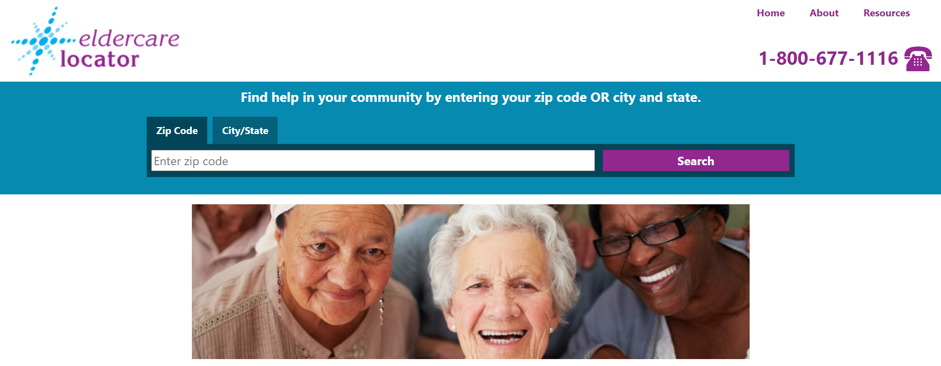
Eldercare Locator
32
https://eldercare.acl.gov
Notes:
Slide link:
https://eldercare.acl.gov

Slide 33
§ 1322.33 Coordination with Tribal, State, and local emergency management.
A tribal organization or Hawaiian Native grantee shall establish emergency plans to include coordinating activities with:
the SUA, any AAAs providing Title III and VII funded services within the tribal organization’s or Hawaiian Native grantee’s approved service area,
local emergency response and management agencies, relief organizations,
local governments, other state agencies responsible for emergency and disaster preparedness,
any other institutions that have responsibility for disaster relief service delivery.
Notes:
Slide link:
https://www.ecfr.gov/current/title-45/section-1322.33

Slide 34
§ 1321.97 Coordination with State, Tribal, and local emergency management.
SUAs shall establish emergency plans and plan shall discuss coordination with AAAs and service providers and tribal and local emergency management.
AAAs shall establish emergency plans that must include coordination with federal, local, and state emergency response agencies, service providers, relief organizations, local and state governments, and any other entities that have responsibility for disaster relief service delivery, as well as with tribal emergency management, as appropriate.
Notes:
Slide link:
https://www.ecfr.gov/current/title-45/section-1321.97

Slide 35
§ 1322.37 Title VI and Title III coordination for emergency and disaster preparedness.
Title VI grantees, SUAs, and AAAs should coordinate in emergency and disaster preparedness planning, response, and recovery.
Title VI grantees must have policies and procedures in place for how they will communicate and coordinate with SUAs and AAAs regarding emergency and disaster preparedness planning, response, and recovery.
Notes:
Slide link:
https://www.ecfr.gov/current/title-45/section-1322.37

Slide 36
§ 1321.103 Title III and Title VI coordination for emergency and disaster preparedness.
SUAs, AAAs, and Title VI programs should coordinate in emergency/ disaster preparedness planning, response, and recovery.
SUAs and AAAs that have Title VI programs in operation within their jurisdictions must have policies and procedures for how they will communicate and coordinate with Title VI programs regarding emergency and disaster preparedness planning, response, and recovery.
Notes:
Slide link:
https://www.ecfr.gov/current/title-45/section-1321.103

Slide 37
Summary and Resources
37

Slide 38
The Older Americans Act
38
Title III – Grants for State & Community Programs on Aging
  Part B – Supportive Services and Senior Centers
  Part C – Nutrition Service
    Subpart 1 (C-1) – Congregate Nutrition Services
    Subpart 2 (C-2) – Home Delivered Nutrition Services
  Part D – Evidence-Based Disease Prevention and Health Promotion Services
  Part E – National Family Caregiver Support Program
Title VI – Grants for Native Americans
  Part A – Indian Program
  Part B – Native Hawaiian Program
  Part C – Native American Caregiver Support Program

Slide 39
Service Alignment in the OAA
39
Service | Title VI | Title III
Transportation | Part A/B | Part B
Information & Assistance / Outreach | Part A/B | Part B
Care Coordination / Case Management | Part A/B | Part B
Chore / Homemaker / Personal Care Assistance | Part A/B | Part B
Legal Assistance | Part A/B | Part B
Congregate Meals | Part A/B | Part C-1
Home Delivered Meals | Part A/B | Part C-2
Evidence-based Disease Prevention/Health Promotion | Part A/B | Part D
Caregiver Support (Caregivers of Elders or people with dementia of any age) | Part C | Part E
Caregiver Support (Older Relative Caregivers caring for children or adults with disabilities) | Part C | Part E

Slide 40
Examples of Title VI & Title III Coordination
Make referrals to Title III programs
Participate on state / AAA advisory council or board
Ask state / AAA to do presentations to elders at Title VI site
Tell elders about presentations/events by the state / AAA
Send Title VI newsletter/emails to state / AAA
Ask to be on distribution list to get state / AAA newsletter/emails
Give input on state and area plans on aging
Serve on other workgroups/committees of state / AAA
Consider collaborating with state / AAA on grant proposals (for example be a host site for falls prevention class)
Apply for Title III and other funding from state / AAA

Slide 41
Example: Title III & VI Aging Programs Roundtable Discussions
Who:
  AAA programs and Virginia SUA, Department for Aging and Rehabilitative Services
  Virginia tribes (Chickahominy Tribe and Monacan Indian Tribe)
Discussion included:
  What the tribes want the AAAs to know and where potential collaborations exist between tribal needs and what the Commonwealth of Virginia and AAAs can do;
  Concerns between tribes and states; and
  Opportunities for Capacity Building and Building Relationships with tribes:
    AAAs and SUA coordinating on need for staff cultural competency training;
    Tribes invited to attend various conferences and/or sessions;
    Invitation for tribal members to serve on AAA Advisory Board; and
    Tribes in attendance invited AAA staff to pow wows in their neighboring areas.

Slide 42
OAIANNHP Main Points of Contact
Name | Role | Email | Phone
Cynthia LaCounte | Director, OAIANNHP | Cynthia.LaCounte@acl.hhs.gov | (202) 795-7380
Cecilia Aldridge | Aging Services Program Specialist, Program Officer | Cecelia.Aldridge@acl.hhs.gov | (301) 844-5669
Jasmine Aplin | Program Analyst | Jasmine.Aplin@acl.hhs.gov | (202) 795-7453
Sonya Begay | Policy Analyst | Sonya.Begay@acl.hhs.gov | (202) 205-9769
David Long | Program Analyst | David.Long@acl.hhs.gov | (202) 795-7320
Sara Vogler | Program Analyst | Sara.Vogler@acl.hhs.gov | (202) 795-7461

Slide 43
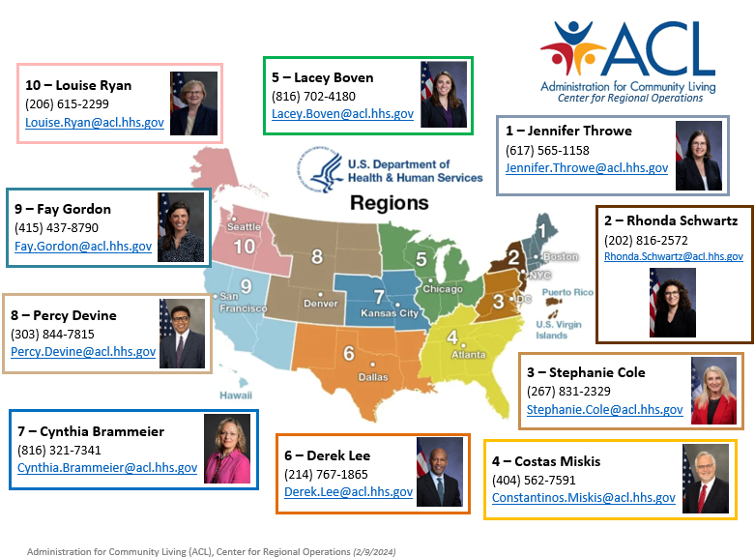
Regional
Administrators

Slide 44
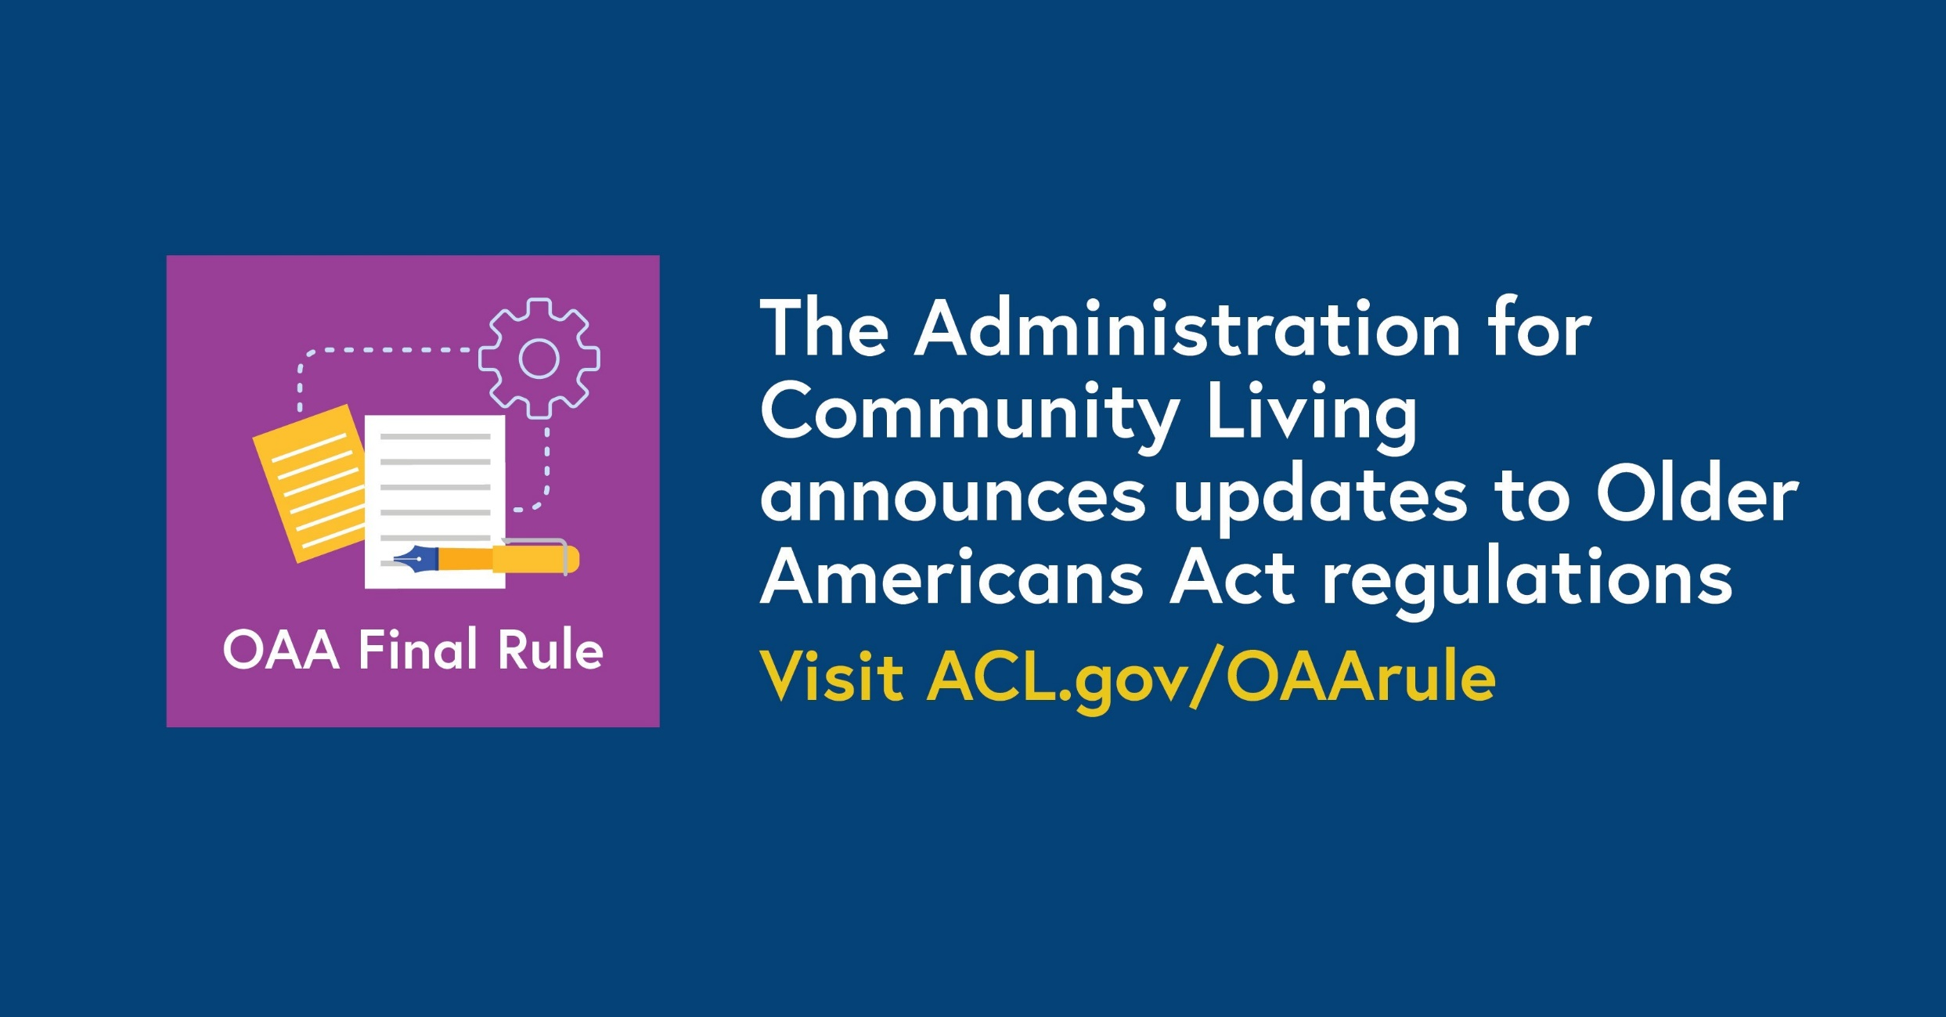
OAA Final Rule Graphic
Notes:
Slide link:
acl.gov/oaarule

Slide 45
OAA Final Rule Resources
ACL's OAA Regulations webpage: https://acl.gov/OAArule
  The Older Americans Act Final Rule
  Recordings of webinars
  Fact sheets
  Information on upcoming webinars and trainings
  Additional resources
Notes:
Slide links:
https://www.govinfo.gov/content/pkg/FR-2024-02-14/pdf/2024-01913.pdf
https://acl.gov/OAArule

Slide 46
ACL Announcements & Updates
46
Sign up at:
https://cloud.connect.hhs.gov/acl-subscriptions
Notes:
Slide link:
https://cloud.connect.hhs.gov/acl-subscriptions

Slide 47
Thank you!
47

